Slide 1

EXPENSE TRACKER
Kanisha Shah Stuti Patel
19BCE253 19BCE269

Slide 2
Problems
In the current scenario we are unable to manage our daily expenses.
Mostly everyone is not consistent in maintaining records of their expenditure. So to be consistent we are here with this project.
In our routine life we lack tracking our daily and weekly expenditure. So we came up with this idea.

Slide 3
FEATURES OF PROJECT
Welcome Page
Login / Sign Up
Adding Your Day-to-Day Expenses
Analysing your Expense

Slide 4
FUNCTIONALITIES
DATE
TITLE
EXPENSE
ADDING EXPENSE
DAILY
WEEKLY
YEARLY
ANALYSING EXPENSE

Slide 5
SOFTWARE REQUIREMENT
MYSQL SERVER
MYSQL WORKBENCH
MYSQL ROUTER
PACKAGES REQUIRED
Pip install tkcalendar
Pip install mysql-connector-python
Pip install matplotlib

Slide 6
LOGIN / SIGN UP
Existing user can login with their username and data will be added to the existing relation in the database.
If existing user tries to Sign-up, it would result with error message and won’t allow the user to do the same.
New users can sign in and a new relation will be created in the same database.

Slide 7
DAY TO DAY EXPENSE
To maintain healthy habit one can regularly add their expense to monitor themselves against the misuse of money and learn from their mistakes
We have connected the GUI to MYSQL database to store the data for future reference
Here, we have validated all the data fields so that wrong data doesn’t get added in the database

Slide 8
ANALYSING OUR EXPENSE
Saving money is the most important lesson in our life. The sooner we learn it the more we save at the end. So, these graphs will help you learn this lesson.
We can control it by analysing the graph, whichever has more area, we can reduce its expense in next week.

Slide 9

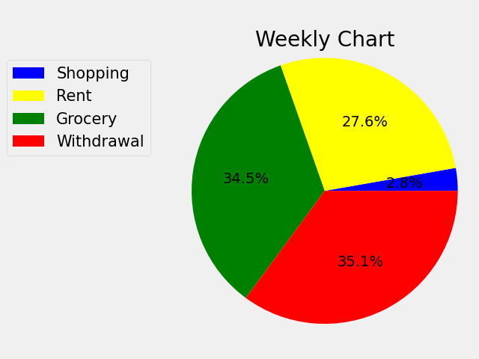
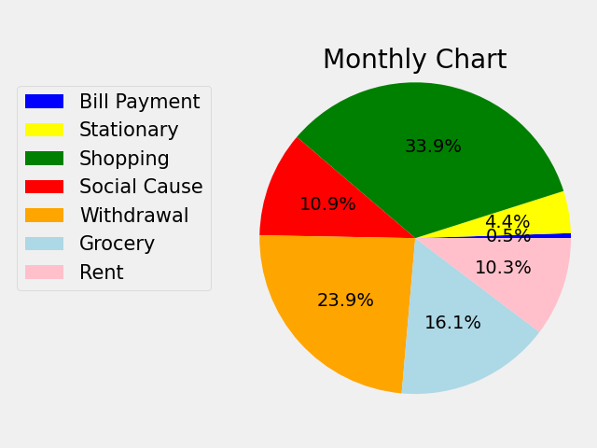
GRAPHICAL ANALYSIS

Slide 10
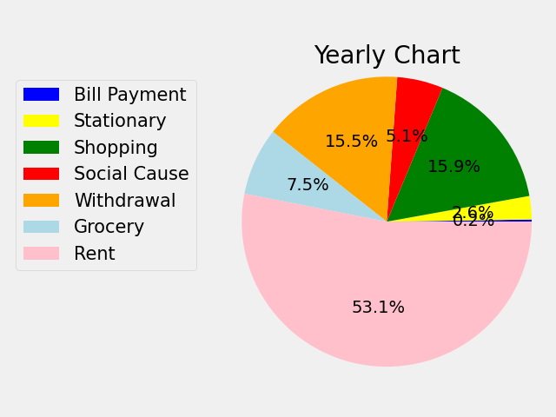
GRAPHICAL ANALYSIS

Slide 11
THANKYOU

